Slide 1

Mongo DB Installation Guide for Windows

Slide 2
Installation
MongoDB – This is the database server.
Mongosh – This is the MongoDB Shell. This will be used in the module to manipulate the documents in MongoDB in command line.
Compass – Optional for module. This is the GUI editor.

Slide 3
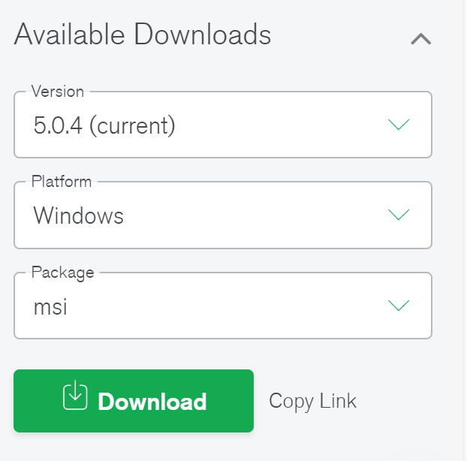
Get the MongoDB community edition for windows installation file: https://www.mongodb.com/download-center/community
Select the Version , Package and OS as shown in the image below:

Slide 4
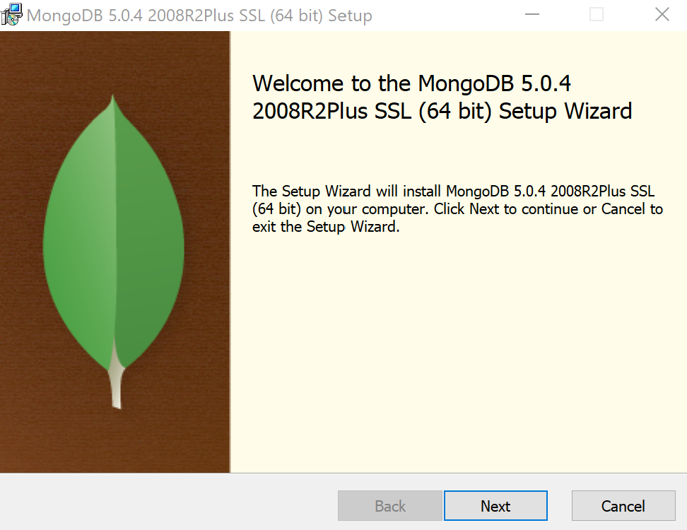
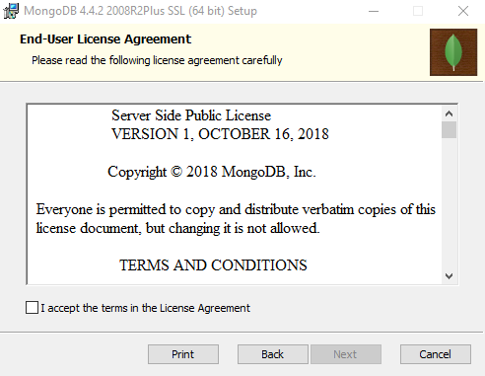
1
2
3

Slide 5
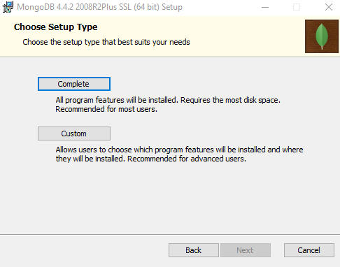
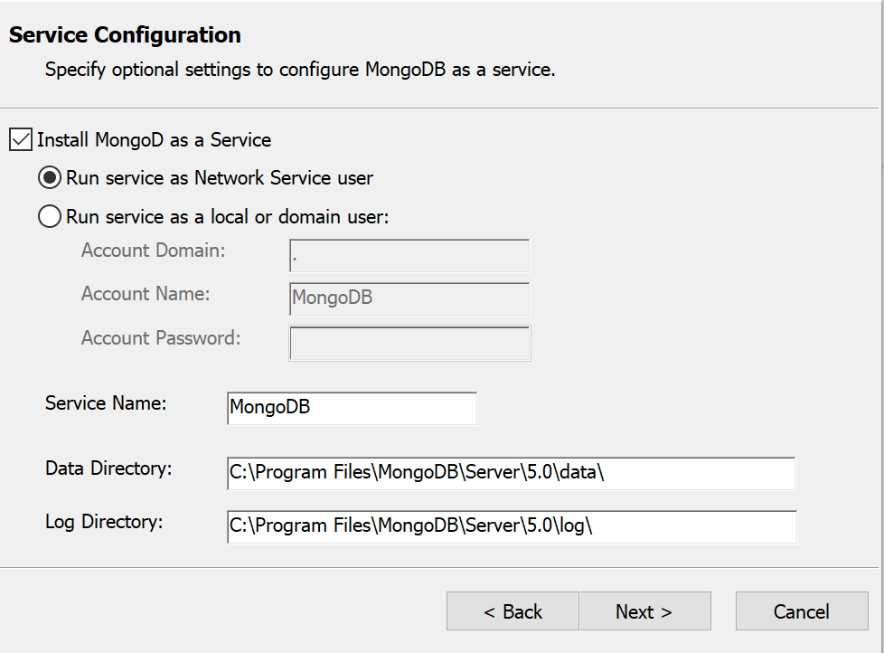
4
5

Slide 6
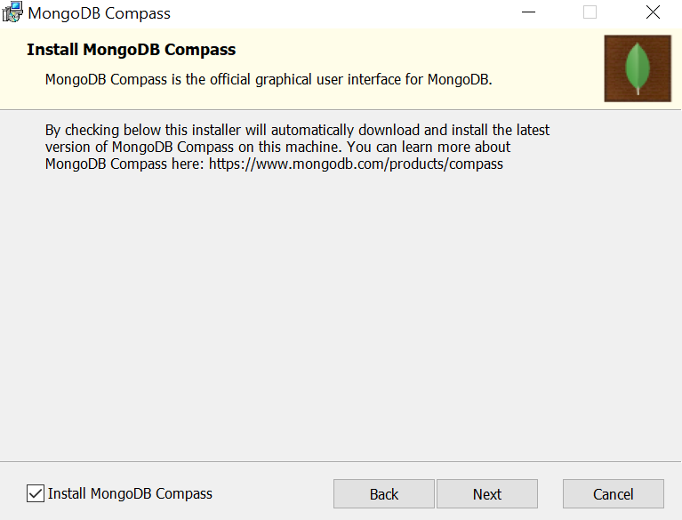
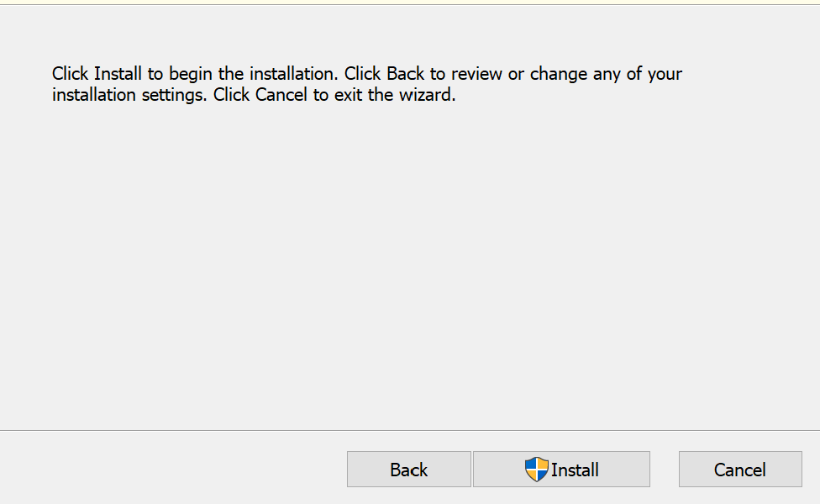
6
Windows will request your permission to allow the install.
Select ‘Yes’ when windows prompt.

Slide 7
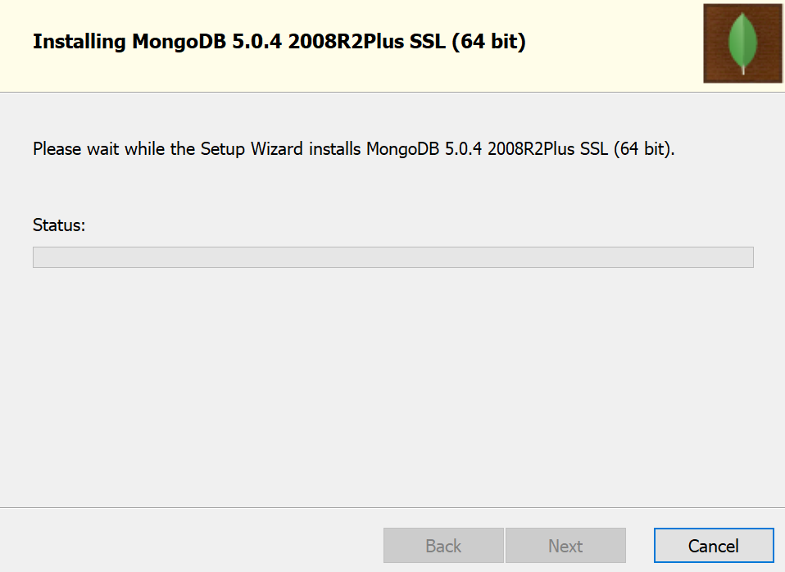
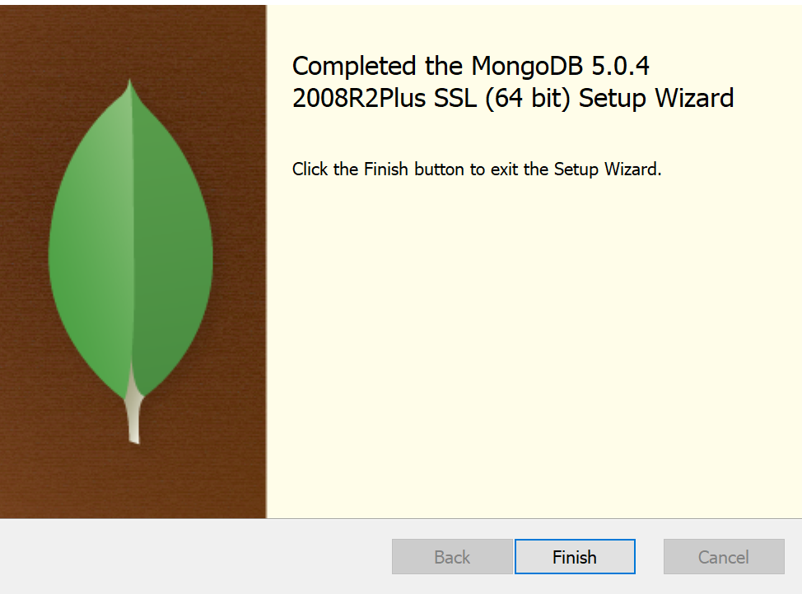
Mongo Compass will start. Close the window.

Slide 8

Install MongoDB Shell - Mongosh

Slide 9
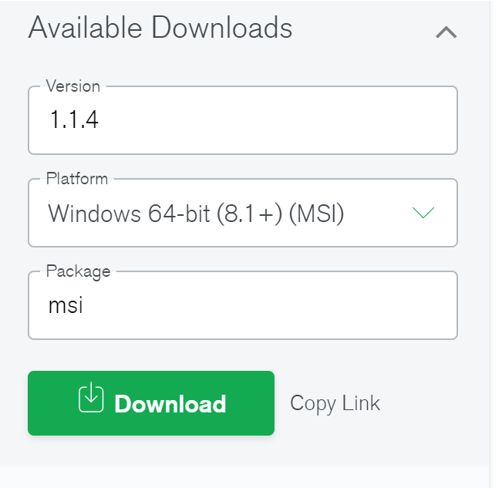
Download the installation file https://downloads.mongodb.com/compass/mongosh-1.1.4-x64.msi

Slide 10
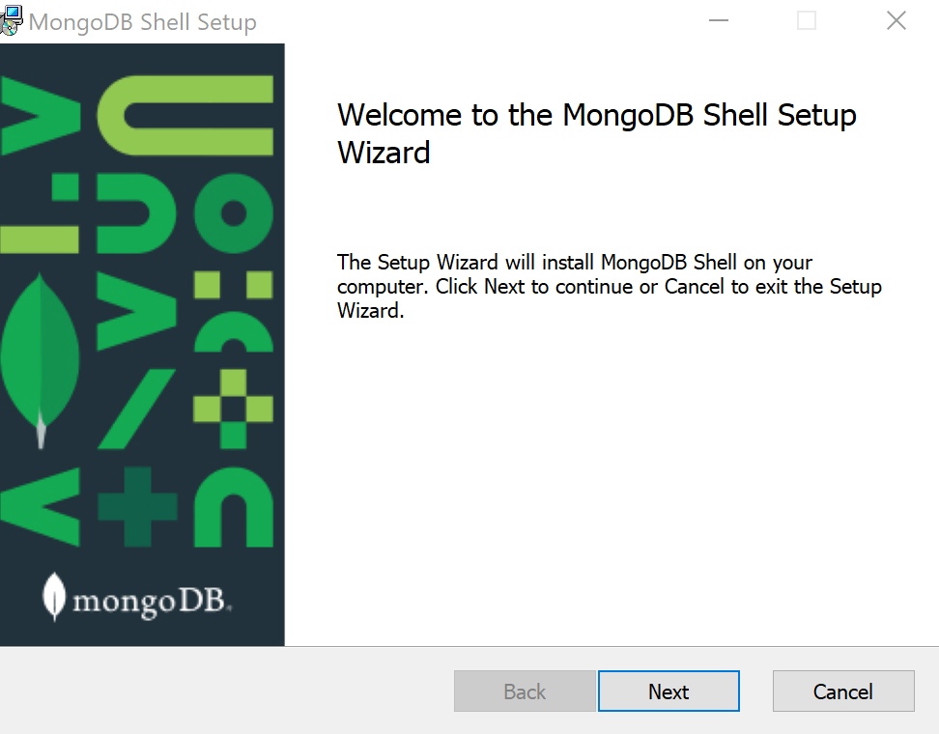
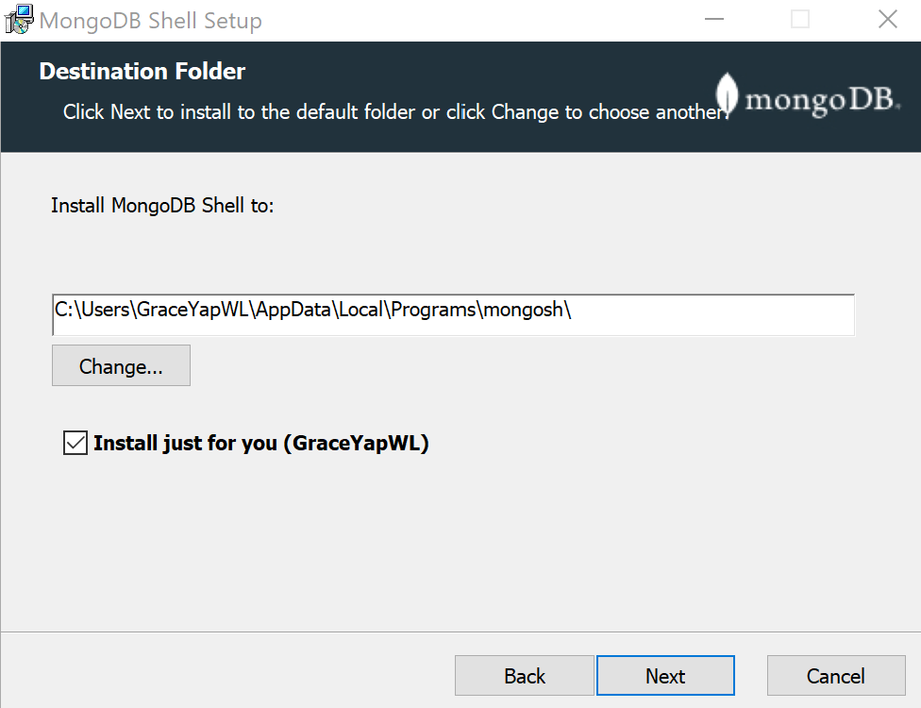
1
2

Slide 11
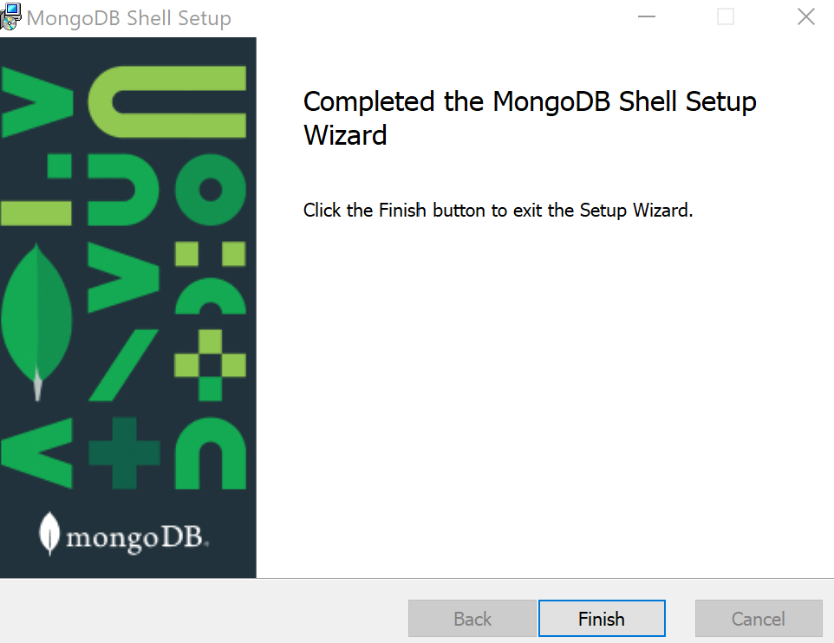
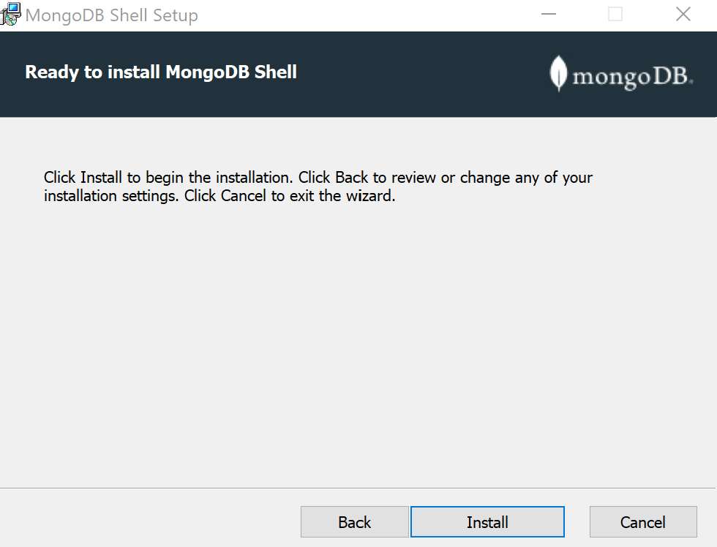
1
2
After installing Mongosh, rename mongo

Slide 12

Starting MongoDB and Using Mongosh

Slide 13
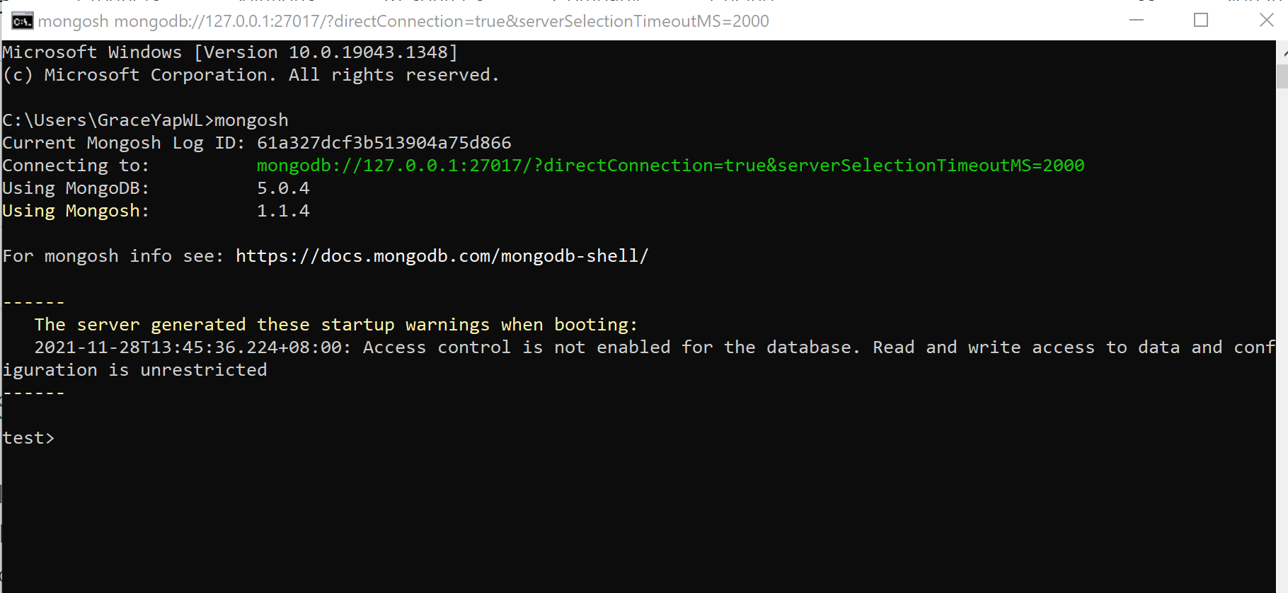
In Command Prompt: Enter mongosh

Slide 14

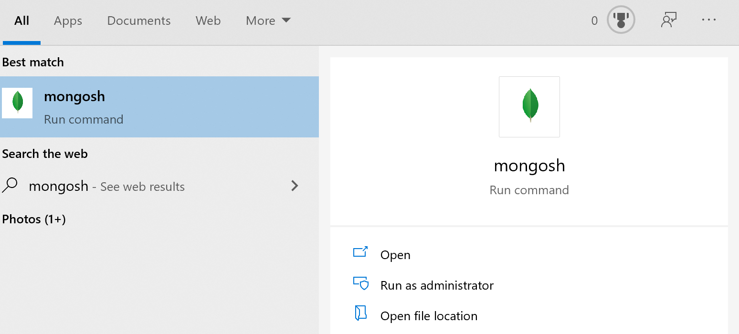
After you restart your computer:
1. Search for mongosh
2. Select the Mongosh command to run it

Slide 15
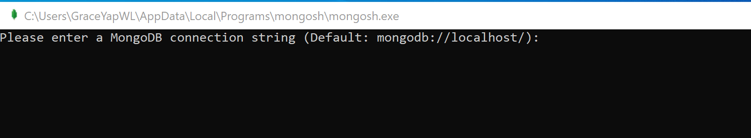
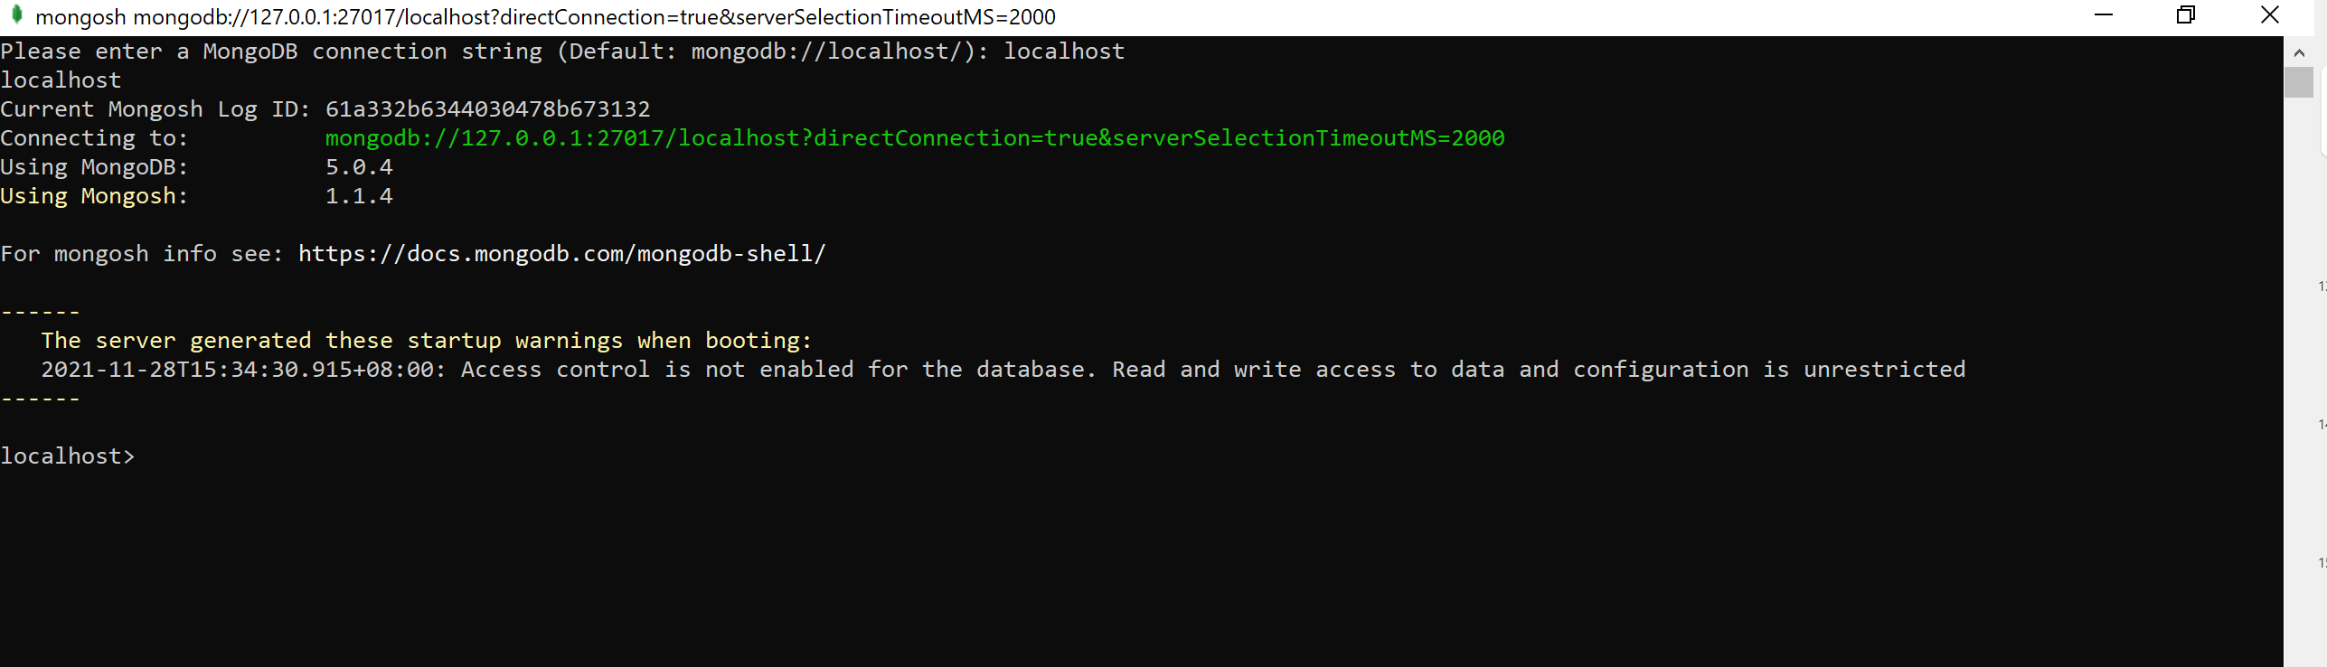
3.Enter localhost at command line prompt

Slide 16
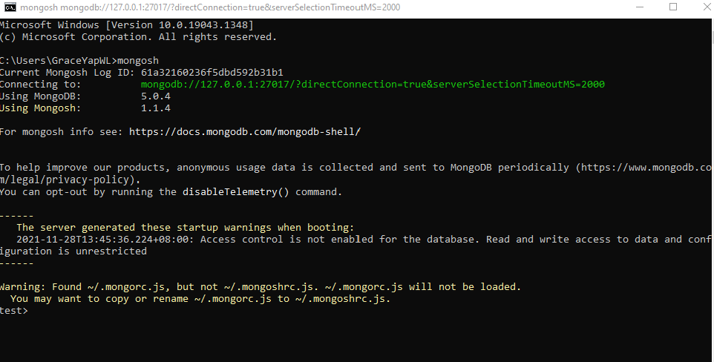
Trouble Shooting: If encounter warning, then rename the file mongorc.js to mongoshrc.js

Slide 17
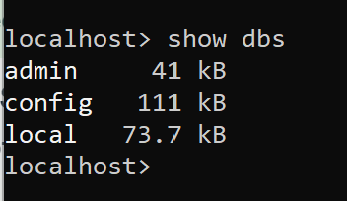
Test the mongo client set-up.
Enter ‘show dbs’ command in the second command line app where you entered ‘mongo’ to activate the mongo db client. It will display the following databases

